Slide 1
Lecture 2
FOIT, University of Central Punjab
Relational Model
1

Slide 2
Relational Model (RM)
RM, proposed by E.F. Codd to model data in the form of relations or tables.
A relation is nothing but a table of values.
Every row in the table represents a collection of related data values.
Rows in the table denote a real-world entity or relationship.
The table name and column names are helpful to interpret the meaning of values in each row.
The data are represented as a set of relations.
FOIT, University of Central Punjab

Slide 3
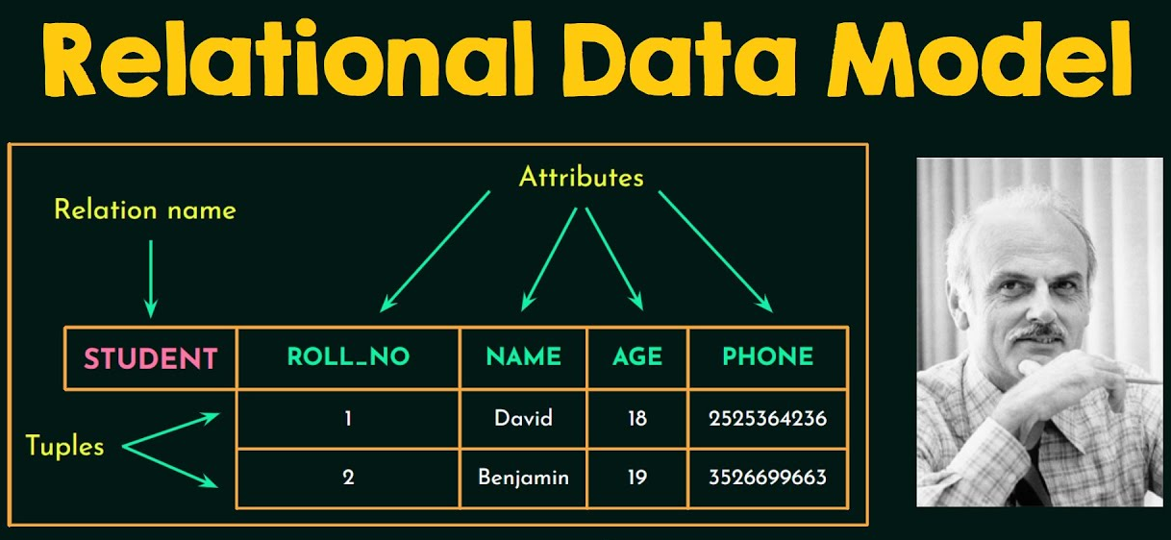
Relational Model (RM)
A relational database stores data in the form of relations (tables).
Consider a relation STUDENT with attributes ROLL_NO, NAME, PHONE and AGE shown in the Table below.
FOIT, University of Central Punjab

Slide 4
RMs Concepts
Attribute:
Each column in a Table. Attributes are the properties which define a relation. e.g., Student_Rollno, NAME, etc.
Tables:
In the Relational model the, relations are saved in the table format. It is stored along with its entities.
A table has two properties rows and columns. Rows represent records and columns represent attributes.
FOIT, University of Central Punjab

Slide 5
RMs Concepts
Tuple:
A single row of a table, which contains a single record.
Relation Schema:
A relation schema represents name of the relation with its attributes. e.g.; STUDENT (ROLL_NO, NAME, ADDRESS, PHONE and AGE) is relation schema for STUDENT.
If a schema has more than one relation, it is called Relational Schema.
FOIT, University of Central Punjab

Slide 6
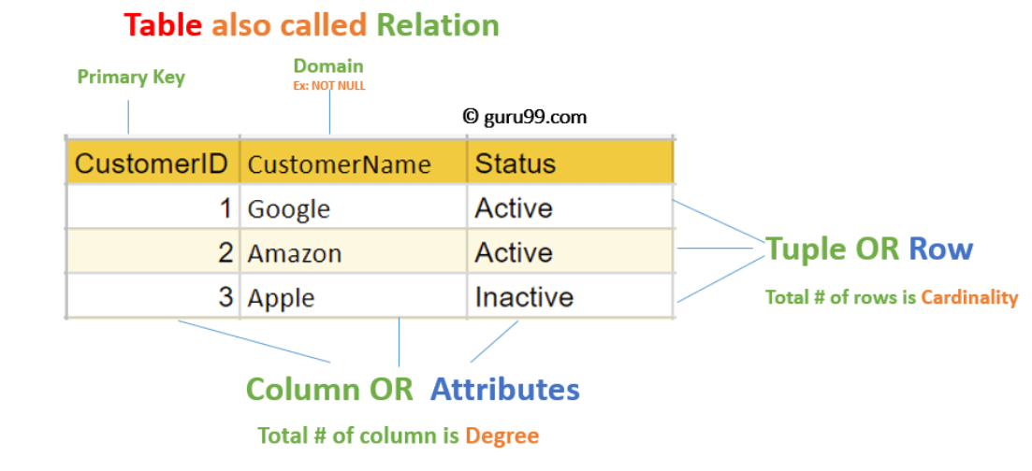
RMs Concepts
Degree:
The total number of attributes which in the relation is called the degree of the relation.
FOIT, University of Central Punjab

Slide 7
RMs Concepts
Cardinality:
The total number of rows present in the Table.
Relation Instance:
The set of tuples of a relation at a particular instance of time.
Below table shows the relation instance of STUDENT at a particular time.
FOIT, University of Central Punjab
Stud_id | Stud_name | Stud_address
1223 | Zain | Street 1, Lahore
1224 | Malik | Street 2, Karachi
1225 | Rehman | Street 5, Lahore

Slide 8
RMs Concepts
Relation key:
Every row has one, two or multiple attributes, which is called relation key.
In the following table, Stud_id is used as a key (primary key).
FOIT, University of Central Punjab
Stud_id | Stud_name | Stud_address
1223 | Zain | Street 1, Lahore
1224 | Malik | Street 2, Karachi
1225 | Rehman | Street 5, Lahore

Slide 9
RMs Concepts
NULL Values:
The value which is not known or unavailable is called NULL value.
It is represented by blank space. e.g.; Stud_phone of STUDENT having Stud_id 1225 is NULL.
FOIT, University of Central Punjab
Stud_id | Stud_name | Stud_address | Stud_phone
1223 | Zain | Street 1, Lahore | 0344934…
1224 | Malik | Street 2, Karachi | 0333456…
1225 | Rehman | Street 5, Lahore

Slide 10
RMs Concepts
Attribute domain:
Every attribute has some pre-defined value and scope which is known as attribute domain
For example, a domain of month-of-year can accept January, February…. December as possible values, a domain of integers can accept whole numbers that are negative, positive and zero.
FOIT, University of Central Punjab
Travler_id | Travler_name | Traveling_Month
1223 | Zain | January
1224 | Malik | February
1225 | Rehman | August

Slide 11
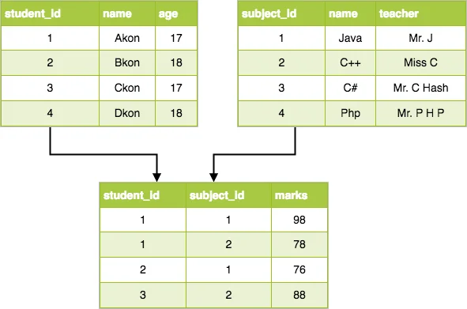
Activity1 Time
FOIT, University of Central Punjab

Slide 12
Constraints of RM
We define some conditions which must hold for data present in database are called Constraints.
These constraints are checked before performing any operation (insertion, deletion and updation) in database.
If there is a violation in any of constrains, operation will fail.
FOIT, University of Central Punjab

Slide 13
Constraints Types
Constraints can be implicit, explicit, or business rules.
Model-based or Implicit Constraints:
Constraints that are applied in the data model is called Implicit constraints.
e.g., duplicate tuples are not allowed in a relation
Age attribute will receive values as Integer
Schema-based or Explicit Constraints:
Directly applied in the schemas of the data model, by specifying them in the DDL (Data Definition Language).
These include Domain, Key, entity integrity and referential integrity constraints
FOIT, University of Central Punjab

Slide 14
Constraints Types
Application-based/Semantic or Business Rules:
Cannot be directly expressed in the schemas of the data model.
Must be expressed and enforced by the application programs or in some other way.
e.g., this year’s salary increase can be no more than last year’s
FOIT, University of Central Punjab

Slide 15
Schema-based Constraints
Domain Constraints:
List of all possible values and data types for the field/attribute.
Numeric data types for integers and real numbers
Required and optional fields
Unique
Default value if value is not provided
Date, time, timestamp
FOIT, University of Central Punjab

Slide 16
Schema-based Constraints
Key Integrity:
Every relation in the database should have at least one set of attributes (e.g., primary key) which defines a tuple uniquely.
Those set of attributes is called key. e.g.; ROLL_NO in STUDENT is a key. No two students can have same roll number. So, a key has two properties:
  It should be unique for all tuples.
  It can’t have NULL values.
FOIT, University of Central Punjab

Slide 17
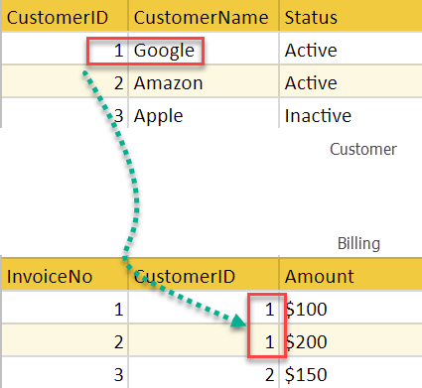
Schema-based Constraints
Referential Integrity:
When one attribute of a relation can only take values from other attribute of same relation or any other relation, it is called referential integrity.
That key element must
exist in the table.
CustomerID is primary key of
the Customer table and
foriegn key in the Billing.
Foreign key refers to primary
key
FOIT, University of Central Punjab

Slide 18
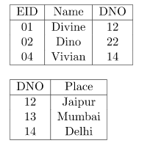
Schema-based Constraints
Referential Integrity:
DNO of the first relation is the foreign key, and DNO in the second relation is the primary key.
DNO = 22 in the foreign key of the first table is not allowed since DNO = 22 is not defined in the primary key of the second relation.
FOIT, University of Central Punjab

Slide 19
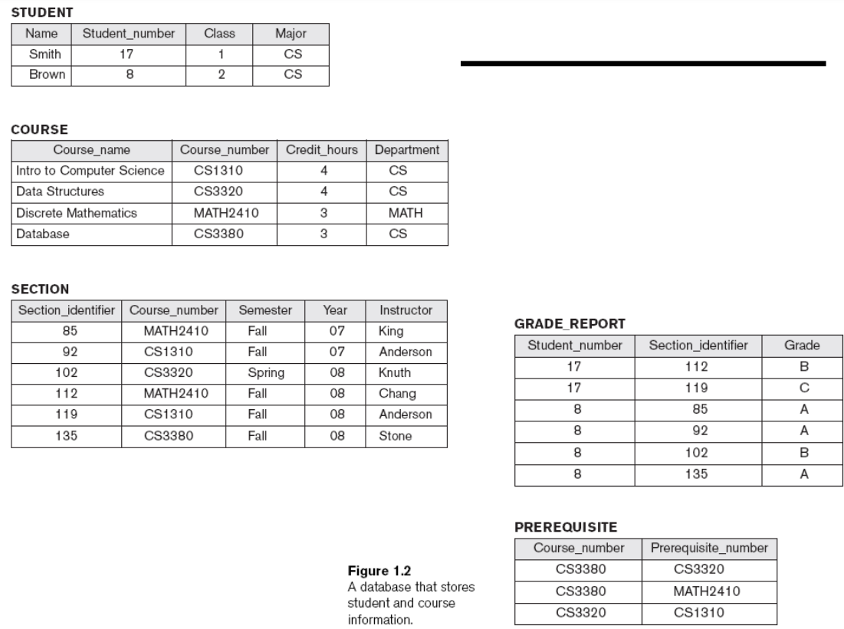
Activity 2
FOIT, University of Central Punjab

Slide 20
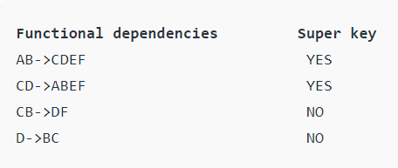
Keys
Super Key:
is an attribute (or set of attributes) that is used to uniquely identify all attributes in a relation.
All super keys can’t be candidate keys but the reverse is true.
In relation, a number of super keys is more than the number of candidate keys.
FOIT, University of Central Punjab

Slide 21
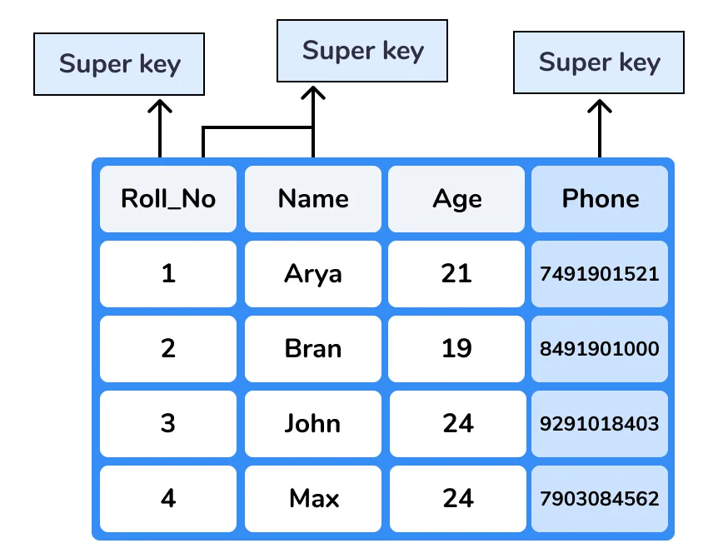
Keys
Super Key:
FOIT, University of Central Punjab

Slide 22
Keys
Candidate Key:
A candidate key is a set of attributes (or attributes) that uniquely identify the tuples in relation to or table.
Superkeys which have a least number of attributes
As Primary key is a minimal super key, so there is one and only one primary key in any relationship but there is more than one candidate key that can take place.
The candidate key’s attributes can contain a NULL value which opposes to the primary key.
Student{ID, First_name, Last_name, Age, Sex, Phone_no}
Here we have two candidate keys, i.e., ID and remaining attributes
FOIT, University of Central Punjab

Slide 23
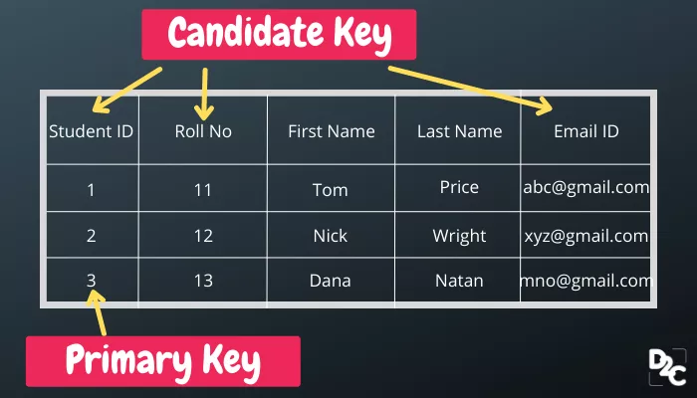
Keys
Candidate Key:
FOIT, University of Central Punjab

Slide 24
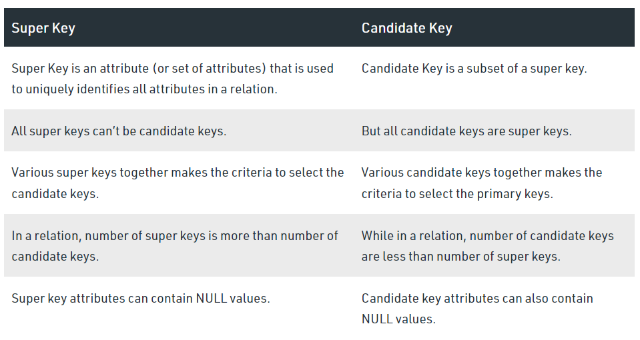
Keys
Candidate Key Vs Super Key:
FOIT, University of Central Punjab

Slide 25
Self Study topics
CRUD operations and relevant constraints in Relational Models
Note: In the next lecture, I will ask about these concepts.
FOIT, University of Central Punjab

Slide 26
Thank You.
FOIT, University of Central Punjab

